Slide 1
COMPLEX TRAUMA
COMPLEX TRAUMATIC STRESS DISORDER [CTSD]

Slide 2
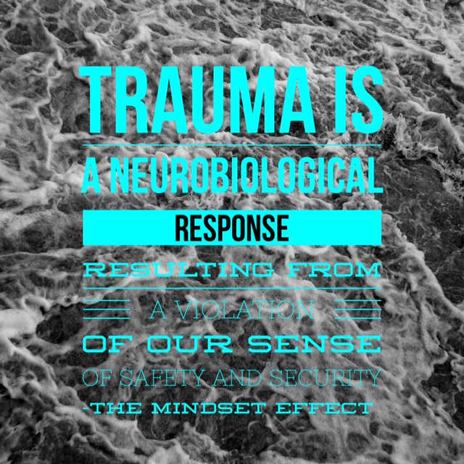

Slide 3
Introduction
Complex Traumatic Stress Disorder
  Is a diagnosable condition
  Includes symptoms of PTSD
  More complex than PTSD
  Identified in lives of those who have been chronically exposed to trauma: child survivors of abuse
Notes:
child survivors of physical, sexual, extreme neglect psychological/emotional abuse
Victims of war, torture
Soldiers; EMS personnel

Slide 4
Widely Different Stressors
War Trauma
Natural Disasters
Man-made Disasters
Physical Assault
Sexual Assault
Accidents

Slide 5
Major Factors
Predicting Psychological Trauma
Fear of torture
Sexual assault
Fear of sexual assault
Watching someone else die, experience extreme pain or physical injury
A belief of failed responsibility that results in harm to others

Slide 6
Major Factors
Predicting Psychological Trauma
Actual severe physical injury, disfigurement, dismemberment or disability
Fear of severe physical injury, disfigurement, dismemberment or disability
Fear of losing one’s life
Torture

Slide 7




Major Factors
Predicting Psychological Trauma

Slide 8
Major Factors
Predicting Psychological Trauma
The belief of unjustified survival or escape/avoidance from harm
The belief of betrayal
Death or injury to children
The violation or contradiction of a “core belief” (e.g. God, friendship, loyalty, fairness, justice, fidelity or competence)

Slide 9
Post Traumatic
Stress Disorder
Breaking it down:
  APTS: Acute Post Traumatic Stress
    Emotional reactions to an event ,lasting up to 30 days
  PTSD: Post Traumatic Stress Disorder
    A diagnosable disorder after 30 days of unrelenting reactions

Slide 10
Prevelance
Among the most common
of psychiatric disorders
Life time prevalence between:
1 and 9 % in general population,
@ least 15% of psychiatric population

Slide 11
Three Core Symptom Clusters
Hyperarousal
Avoidance
Re-experiencing

Slide 12
Symptoms of PTSD –
3 Major Categories
Re-experiencing: symptoms occur when aspects of the traumatic event are relived in some way
Avoidance: symptoms include attempts to stay away from ‘triggering’ locations/people.
Amnesia for traumatic events falls under the Avoidance category

Slide 13
Symptoms of PTSD
3. Hyperarousal: symptoms include being constantly on high alert for danger. They experience high anxiety; angry outbursts; irritability; and sleep disturbance.
PTSD can occur from one traumatic event, or a cluster of traumatic events

Slide 14
Comorbidity of PTSD with other Psychiatric Disorders

Slide 15
Physical symptoms
Gastrointestinal
(Peptic ulcer)
Cardiovascular
(heart palpitations)
Respiratory
(Asthma)
Tension Headaches and Migraines
Muscular
(back, neck and joint pain)
Menstrual issues

Slide 16

QUESTIONS?

Slide 17
Pathways of Disorders
Equifinality - you can have multiple risk factors and one outcome.
genes
PTSD
biologic
abuse/chaos
injury

Slide 18
Pathways of Disorders
Multifinality - one risk factor has multiple outcomes.
Borderline Personality
Emotional Dysregulation Depression/Anxiety
Can be symptoms of PTSD
Trauma Criminality
PTSD

Slide 19
COMPLEX TRAUMATIC
STRESS DISORDER
No cohesive complex trauma literature
DSM IV has diagnostic categories that have criteria specifying a trauma history [PTSD & Acute Stress Disorder].
Neither diagnosis has the criteria that encompasses the additional symptoms discussed in child abuse literature. (Gingrich, 2013)

Slide 20
COMPLEX TRAUMATIC
STRESS DISORDER
While symptoms for CTSD include those all found in PTSD they also include the following:
  Distorted views of self
  Low self esteem; self hatred
  Self blame for abuse
  High degrees of guilt and shame
  Impaired identity formation – identity confusion
  Severely impaired trust which interferes with the development of healthy relationships
CTSD is not restricted to survivors of childhood sexual abuse (SA) abuse literature has primarily informed the current understanding of complex trauma.

Slide 21
Symptoms of CTSD
Difficulties with:
  Affect (emotional) regulation
  Dissociation (the disconnection or separation of mind , will and emotion from the physical body; in extreme cases the spirit /soul can also dissociate with the symptom of actually being dead)
  Self perception
  Perception of perpetrator
  Relationships
  Physical problems
  Systems of meaning

Slide 22

CTSD
The prerequisite condition of
CTSD
is the experience of being
totally controlled over a period
of months or years.

Slide 23

CTSD
Others fitting CTSD criteria include:
  Hostages
  Prisoners of war
  Concentration camp survivors
  Survivors of religious cults
  Victims of continual intimate partner violence
  (Herman, 1992/1997)

Slide 24

COMPARING
Literature on war-related trauma
Isolated traumatic events
Trauma source not usually an intimate relationship
Examples: war-related trauma, natural disasters, single rape (adult), physical injury
Relatively short term therapy
PTSD
Literature on Childhood Sexual abuse
Multiple traumatic events; chronic trauma
Trauma source includes intimate relationships
Examples: CSA and/or neglect [physical, sexual, emotional, spiritual or combinations; domestic violence.
CTSD
Long term therapy

Slide 25


Slide 26
DSM-IV-TR CRITIERIA for PTSD
A history of exposure to a traumatic event meeting two criteria and symptoms from each of three symptom clusters:
  intrusive recollections,
  avoidant/numbing symptoms,
  and hyper-arousal symptoms.
  A fifth criterion concerns duration of symptoms and a sixth assesses functioning.
Notes:
Criterion A: stressor
The person has been exposed to a traumatic event in which both of the following have been present:
The person has experienced, witnessed, or been confronted with an event or events that involve actual or threatened death or serious injury, or a threat to the physical integrity of oneself or others.
The person's response involved intense fear, helplessness, or horror. Note: in children, it may be expressed instead by disorganized or agitated behavior.
Criterion B: intrusive recollection
The traumatic event is persistently re-experienced in at least one of the following ways:
Recurrent and intrusive distressing recollections of the event, including images, thoughts, or perceptions. Note: in young children, repetitive play may occur in which themes or aspects of the trauma are expressed.
Recurrent distressing dreams of the event. Note: in children, there may be frightening dreams without recognizable content.
Acting or feeling as if the traumatic event were recurring (includes a sense of reliving the experience, illusions, hallucinations, and dissociative flashback episodes, including those that occur upon awakening or when intoxicated). Note: in children, trauma-specific reenactment may occur.
Intense psychological distress at exposure to internal or external cues that symbolize or resemble an aspect of the traumatic event.
Physiologic reactivity upon exposure to internal or external cues that symbolize or resemble an aspect of the traumatic event
Criterion C: avoidant/numbing
Persistent avoidance of stimuli associated with the trauma and numbing of general responsiveness (not present before the trauma), as indicated by at least three of the following:
1. Efforts to avoid thoughts, feelings, or conversations associated with the trauma
2. Efforts to avoid activities, places, or people that arouse recollections of the trauma
3. Inability to recall an important aspect of the trauma
4. Markedly diminished interest or participation in significant activities
5. Feeling of detachment or estrangement from others
6. Restricted range of affect (e.g., unable to have loving feelings)
7. Sense of foreshortened future (e.g., does not expect to have a career, marriage, children, or a normal life span)
Criterion D: hyper-arousal
Persistent symptoms of increasing arousal (not present before the trauma), indicated by at least two of the following:
1. Difficulty falling or staying asleep
2. Irritability or outbursts of anger
3. Difficulty concentrating
4. Hyper-vigilance
5. Exaggerated startle response
Criterion E: duration
Duration of the disturbance (symptoms in B, C, and D) is more than one month.
Criterion F: functional significance
The disturbance causes clinically significant distress or impairment in social, occupational, or other important areas of functioning.

Slide 27
Criterion A - Stressor
The person has been exposed to a traumatic event in which both of the following have been present:
  The person has experienced, witnessed, or been confronted with an event or events that involve actual or threatened death or serious injury, or a threat to the physical integrity of oneself or others.
  The person's response involved intense fear, helplessness, or horror. Note: in children, it may be expressed instead by disorganized or agitated behavior.

Slide 28

Criterion B:
Intrusive Recollection
The traumatic event is persistently re-experienced in
at least one of the following ways:
  Recurrent and intrusive distressing recollections of the event, including images, thoughts, or perceptions.
  Recurrent distressing dreams of the event.

Slide 29
Criterion B:
Intrusive Recollection
Acting or feeling as if the traumatic event were recurring
Intense psychological distress at exposure to internal or external cues that symbolize or resemble an aspect of the traumatic event.
Physiologic reactivity upon exposure to internal or external cues that symbolize or resemble an aspect of the traumatic event

Slide 30
Criterion C:
Avoidant/numbing
Persistent avoidance of stimuli associated with the trauma and numbing of general responsiveness (not present before the trauma), as indicated by at least three of the following:
  Efforts to avoid thoughts, feelings, or conversations associated with the trauma
  Efforts to avoid activities, places, or people that arouse recollections of the trauma
  Inability to recall an important aspect of the trauma

Slide 31
Criterion C:
Avoidant/numbing
  Markedly diminished interest or participation in significant activities
  Feeling of detachment or estrangement from others
  Restricted range of affect
  Sense of foreshortened future

Slide 32

Criterion D:
Hyper-arousal
Persistent symptoms of increasing arousal (not present before the trauma), indicated by at least two of the following:
  Difficulty falling or staying asleep
  Irritability or outbursts of anger
  Difficulty concentrating
  Hyper-vigilance
  Exaggerated startle response

Slide 33

Criterions E and F
Duration of the disturbance :
  symptoms in B, C, and D are more than one month.
Functional significance :
  The disturbance causes clinically significant distress or impairment in social, occupational, or other important areas of functioning.

Slide 34


Slide 35
Formal Assessment Models
Dissociative Experiences Scale (DES) (public domain)
Somatoform Dissociation Questionnaire (SDQ-5) short form
Structured Clinical Interview (SCID –D) –considered the gold standard
Dissociative Disorders Interview Schedule (DDIS) – takes less time than the SCID

Slide 36
Informal
Verbally ask similar kind s of questions on the SCID
Therapists working in the field tend to become familiar enough with how dissociative symptoms tend to be experienced by individuals and then watch for signs in their clients.

Slide 37
Continuum of Dissociation
Normal Consciousness | Dissociative Episode | Acute Stress PTSD Disorder CTSD (4 wks) (4wks +) | Dissociative Disorder [CTSD] | DID
Highway hypnosis | Religious experiences. | Flashbacks Numbness, Detachment | Dissociative Amnesia | DID
Ego states | (e.g., meditation, ecstatic exp. | Absence of Emotional Response | Dissociative Fugue | Poly- Fragmented DID
Automatisms |  | Reduced awareness of surroundings | Dissociative Trance disorder
Childhood imagery |  | De-realization | Possession trance disorder
Absorption/ Daydreaming |  | De-personalization Amnesia for aspects of trauma
2004 2005 2006 2007 2008 2009 2010
Description of the contents
Description of the contents
Description of the contents
Description of the contents
Notes:
We all dissociation to some extent or another –
normal in that we are not fully aware of all aspects of our experience at all times.
Religious Experiences can be dissociative in nature;
we can be caught up in worship or meditation so that we are not aware of the other people around
None of these experiences would be considered dysfunctional unless taken to the extreme
Children dissociate more than adolescents and adolescents more than adults except for the cases of creative individuals who retain an ability to dissociate as it helps them perform.

Slide 38
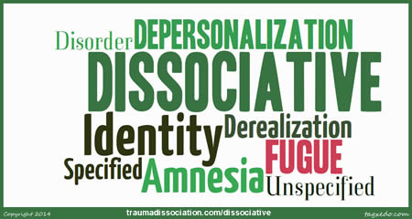
Dissociation
A psychological mechanism by which discrete states are kept separate and trauma states are formed.
Can be defined as a disruption in the usually integrated function of consciousness, memory, identity, sensation, motor function, or perception of the environment.
(Gingrich, 2013)

Slide 39
Dissociation of the Person
CTSD
Time Loss
Insomnia
Mania
Feeling Numb
Irritability
Out of body experience
Self-mutilation
Suicidal Ideation
Phobias
Mood Swings
Flashbacks Anorexia/Bulimia
De-realization
De-personalization
Identity Confusion
Identity Altera-tion
Amnesia

Slide 40

Derealization
One’s surroundings or
other people seem
strange or unfamiliar
Identity Confusion
Identity Alteration
Notes:
DEREALIZATION:
Getting lost on the way home, because their neighbourhood looks unfamiliar
A client told her family that she slept through class during most of kindergarten, “but I know I wasn’t asleep… I felt like I w awake… the classroom was different… it was like cloudy.
IDENTITY CONFUSION
Highly dissociative individuals often struggle profoundly with their sense of identity. With their sense of self and identity. Become confused as they try to sort out who they really are.
IDENTITY ALTERATION
Assuming different identities that are much more distinct than separate social or functional roles. Feel as if they are a different person
A distinguishing feature of DID.

Slide 41
Depersonalization
Sense of detachment from self
Sense of alienation from self
Rapid moods swings and emotional outbursts that feel out of the person’s control – disconnected from body and behavior
  .
Notes:
Going through the motions but feeling like a robot
E.g. seeing myself typing as though I were another person looking on.
looking at the form in the mirror and having no felt sense that the image looking back is actually me
Emotional Outbursts that feel out of the person’s control – disconnected from body and behavior

Slide 42
Identity Confusion
Struggle profoundly with their sense of self & identity
This is due to the lack of integration of states (emotions, experiences with memory)
Due to so much inconsistency people become very confused as they try to sort out who they really are.

Slide 43
Identity Alteration
The assuming of different identities that are much more distinct than social or functional roles
Often feel they are a different person/give themselves different names
Feedback from others is they seem like a different person
Often feel like they’re a different age

Slide 44
Amnesia
Specific and significant memory blocks for time that has passed but cannot be accounted for
Current memory gaps for hours or days at a time
Amnesia is the main symptom of dissociative amnesia disorder
Notes:
Clients have gaps of memory regarding the past i.e. 9-12 years of age; present gaps of not remember meeting classmates, or forget how old they are.

Slide 45
Soul - Body

Slide 46
Fragmentation (DID)
Notes:
Occurs in the soul/spirit; emotional disruption and fragmentation of experience.
2 yrs old; parents die in accident, child sent to live with mother’s brother/wife
5 yrs old; sexually abuse begins with an older cousin
9 yrs old; child sexually abused by teen age boys
13 yrs old; raped returning from school
17 yrs old; kidnapped and raped
Attachment strategies compromised at 2 years old

Slide 47
EARLY CHILDHOOD TRAUMA
Disrupts the process of learning how to regulate emotion.
An insecure, disorganized attachment style often develops (especially if a parent is the perpetrator).
Affect (emotion) regulation is a symptom of many psychological problems

Slide 48
Stuck in Addictive Behaviors
Any experience/situation that parallels or approaches
original hurt must be warded off with controlling behavior.
Controlling Behaviors
Original Hurt
Fear of Loss
Relational Handicaps
Rage
Despondency
Dependency
Shame
Frustration over unmet needs
Addiction
Dissociation
Unconscious triggers
(Ability to ward off
Unpleasant feelings)
Conflict with Others

Slide 49

CTSD clients with a strong belief system may have difficulty relating areas of faith and church involvement to secular therapists
Secular therapists may struggle in understanding health and unhealthy spirituality
What about prayer?
Notes:
Christian clients often choose Christian therapists expressly because they want the freedom to tackle issues of faith as part of the therapeutic process

Slide 50
Spiritual & Existential Concerns
The need for counsellors/pastors prepared to wade through complicated questions of meaning alongside their clients.
Simplistic answers or even a prayer begging God to take care of the Christian in the coming week could easily originate out of an overwhelmed counsellor’s feelings of helplessness!
When & how prayer is used are relevant therapeutic questions

Slide 51
The Demonic
Posttraumatic symptoms have often been assumed to have a spiritual cause. This doesn’t mean that there could not be a spiritual evil connected to the symptoms; but the symptoms themselves are not evil
Toxic churches can create further damage and helping the client understand the difference between a healthy church community and a toxic one is important

Slide 52
PROCESS OF THERAPY
Psycho-education is extremely important.
Understanding the whole process can make a considerable difference to how therapy proceeds.
Some people come knowing they have a trauma history with the express intention of working through the trauma.
Others come for apparently unrelated reasons and pastors/counsellors may miss the possible associations

Slide 53


3 Phase Treatment Model
Safety & Stabilization
Trauma Processing
Consolidation & Resolution
Herman (1992/1997)

Slide 54
Phase 1- Assessment
If posttraumatic or dissociative symptoms are displayed; therapists need to determine whether their clients have PTSD or CTSD.
Phase one can last from several months to a sometimes years, as assessment expands with trauma history
Sometimes clients chose not to progress beyond
Phase 1
Notes:
A thorough personal and family history and experience assessment in the first couple of sessions should reveal events that might lead to trauma.

Slide 55
Safety & Stabilization
Develop rapport
Become a safe person
3. Remain a safe person
Notes:
Develop Rapport:
Foundational skills of empathy, respect and authenticity.
CTSD clients have a radar for phoniness
Valuing counsellees as people made in the image of God
- no matter the behaviors
Sensitive humor… i.e. hokey pokey!

Slide 56
Safety & Stabilization
Often re-experiencing of post traumatic symptoms is what propels CTSD clients to come to therapy
If clients have been wounded by other therapists or social workers or religious leaders, however inadvertently, establishment of a secure therapeutic relationship becomes even more important.

Slide 57
Becoming a Safe Person
Respect uniqueness
Know your limitations
Give Advanced warning
Notes:
Counsellors who lack awareness of their limitations are not safe for their clients
Advanced warning: a sense of predictability
vacations
any time you’re away
process changes

Slide 58
Remaining a Safe Person
Keep appropriate Boundaries
Consult
Protect Confidentiality
Notes:
Boundaries: degree of accessibility
I,e. church
use of touch can be potentially dangerous
discuss the impact
Seek consultation from seasoned professionals/ regular supervision
Protect confidentiality
pastoral counselors or lay counsellors who work within a church setting may be especially susceptible to inadvertently breaking confidentiality.

Slide 59
Safety from Others
Trauma survivors may not always recognize people or situations that put them at risk of re-traumatization
Identify healthy vs unhealthy relationships
Help clients find physical safety
Notes:
Trauma survivors tend to discount their own internal warning signals with respect to individuals how have shown them some care and attention
They tend to give up personal power too easily.
i.e. an incest survivor may be conflicted on whether or not to attend a family gathering knowing the perpetrator is there.
what can you do to stay safe?
have a plan

Slide 60
Safety from Self and Symptoms
Making sense of symptoms
Therapeutic use of dissociation
Dealing with self-destructive and suicidal tendencies
Early symptom containment including medication
Notes:
Not all symptoms are bad… alerts that something is wrong
Helpful to interpret as self- induced, albeit dysfunctional ways of coping
Therapeutic use of Dissociation:
use of ‘parts’ self language/ different aspects of same person
contracting for symptom management
Most CTSD clients report feeling various degrees of fragmentation or compartmentalization. They understand the ‘parts of self’ languauge – it makes sense… always feels like I’m not whole
Contracting for symptom management: key is to connect with whatever part of the person holds the key to the locked room..
Addressing the individual as a whole person and then requesting the part who knew why a particular symptom was manifesting be willing to communicate that information somehow.: i.e. with nightmares

Slide 61
Safety from Self
Additional techniques
  Dissociation to contain overwhelming affect: visualize some place inside self they could ‘store’ the emotion till next week
  Leave [emotion/memory] at the office in a file… (must be explored next time)
Notes:
Con’t from last slide
invite all parts of person to listen in. “do you have a sense that the whole of you is listening?”
Counsellor introduces self – you cannot assume the fragmented parts have been aware of what is happening
Explain the situation: client is exhausted due to nightmares. “There must be a reason for the nightmares… we’re listening. While you want to help [person} dal with things the opposite is happening” she is exhausted from not sleeping and that makes it even harder to cope.” “Would you be willing to make an agreement?” If [person] agrees to deal with things gradually during the day would you be willing to temporarily stop the nightmares?”
This is not a ‘new age philosophy’.. It is simply finding the key; the part of [person] who controlled the nightmares

Slide 62
Safety from Self
  Suicidal Ideation
  Self harm
    Not always possible to keep a CTSD safe from self harm
    Injurious behaviours fit into 2 general categories:
      Attempts to numb emotional pain [drugs/alcohol; self-mutilation]
      Trauma re-enactments [promiscuous unprotected sex;
      prostitution; staying with a violent partner; voluntary contact with perpetrators who continue the abuse].
      (Gingrich, 2013)
Notes:
Story of grandmother/aunt from Mississippi : selective mutism
Suicide ideation/self harm: common with CSTD clients:
some clients battle direct suggestions made by predators
For CTSD with DID suicidal impulses may be subjectively experienced as homicidal impulses: one part wants to get rid of another; doesn’t recognize there is just one body. Contracts MUST BE MADE IN PHASE 1; for set period of time. It is important the whole person agrees.
Not always possible to make a CTSD safe from self harm – long term goal
Choose your battles
Ideomotor signaling – helps to minimize the potential confusion that can arise when clients try to respond verbally. Develop a system with the client for yes/no
Prepare clients well in advance and get consent
“I sometimes use a kind of short cut to get in touch with aspects of people’s experiences that they are not aware of. I have found it helpful for some of my counselees to use finger signals to respond to some of my questions about things they wouldn’t have an answer to. If you agree to this what kind of signals would allow that part of you that knows the answer to respond using your body, but bypassing your conscious mind?

Slide 63
Dealing with Dissociation
Dissociation means you feel separated from what’s happening in your life.
Feeling dissociated can be scary, but it’s a common reaction to an extremely stressful situation.
When your mind becomes overwhelmed, dissociation can provide a way to cope.
Start by learning to recognize your dissociative episodes, which is necessary in order to address them.
Next, learn to ground yourself in the present, which can stop dissociation.
To overcome persistent, recurring dissociation, you’ll likely need to go to therapy.

Slide 64
Dealing with Dissociation
Ask for help identifying when you dissociate, if necessary. It’s normal to not realize when you're dissociating. Luckily, it’s easy for the people who care about you to notice, as you’ll likely appear as though you’re in a daze. Ask them to help you recognize when this happens.
You could say, “I know that I tend to dissociate when things get rough, but it’s hard for me to notice when I’m doing it. Can you tell me if I look spaced out?”

Slide 65
Dealing with Dissociation
Watch for common symptoms of dissociation. This will help you recognize when you’re having episodes.
Write down the symptoms you experience, as well as what was happening at that time.
Keep in mind that dissociation occurs on a spectrum, with daydreaming or zoning out while driving along a familiar road being minor dissociative experiences.
On the opposite end of the spectrum is dissociative identity disorder, which is a serious condition.
Common symptoms include:

Slide 66
Dealing with Dissociation
Feeling detached or spaced-out
Feeling that your mind is blank or wandering
Feeling as though your world isn’t real
Feeling numb
Feeling sleepy when you need to deal with things
Feeling like you’re watching your life from the outside
Feeling like you’re detached from your life or self
Feeling like you’re separate from your surroundings
Staring at 1 spot or with eyes glazed over
Struggling to explain how you feel
Experiencing delayed reactions to things that happen to you

Slide 67
Dealing with Dissociation
Notice how you feel when you dissociate. This will help you identify episodes so that you can try to stop dissociating. Pay attention to your thoughts, sensations, and feelings. You should also notice triggers that occur often, as this will help you identify what is causing your dissociative episodes so that you can overcome them. Ask yourself these questions:
  How do I feel? For example, you might feel detached, foggy, or like you’re floating above the situation.
  What am I thinking? You might have trouble forming thoughts or find that your mind has gone blank.
  What’s happening right now? You might identify what’s stressing you out.

Slide 68
Dealing with Dissociation
Keep a journal to help work through your experiences. Journaling is a great way to work through your emotions and cope with difficult experiences. Not only can journaling help you keep track of your episodes and learn to process them, it can also help you process your past.
Write in your journal every day. Document your everyday life, your feelings about the past, and your dissociative experiences.
When you do notice an episode, record what lead up to it and how you felt.
In some cases, you might choose to bring your journal with you to your therapy sessions, if you go to therapy.

Slide 69
Dealing with Dissociation
Understand that there are different kinds of dissociation. Some people will experience dissociation for short periods of time, often in response to stress or trauma. Others can experience it long-term, such as with Dissociative Identity Disorder.[7] No matter how long your experiences last, they can limit your engagement with your own life, so you deserve to feel better. Here’s a breakdown of the common dissociative disorders:
Depersonalization disorder occurs when you feel detached from your life or yourself.
Dissociative amnesia occurs when you forget parts of your life, often to mask a trauma.
Dissociative fugues occur when you forget who you are and also travel to a new, unfamiliar location.

Slide 70
Dealing with Dissociation
Dissociative Identity Disorder (DID), previously known as multiple personality disorder, occurs when your mind develops separate personalities to help you cope with trauma or stress.
Dissociative Disorder Not Otherwise Specified (DDNOS) is diagnosed when you experience symptoms of dissociation but don’t meet the requirements for diagnosis for any particular disorder.

Slide 71
Dealing with Dissociation
Grounding in the Present
  Describe where you are at this moment. This is a simple way to remind yourself of where you are. Start by stating the location, then try to list as many details about it as you can. By doing this, you’ll be able to come back to the situation you’re in rather than feeling detached.
  For example, you might say this: “I am at the dinner table. My sister is here eating with me. We are eating cereal. The cereal tastes very sweet and smells fruity. I’m wearing pajamas that feel soft on my skin. My sister is talking to me. She’s asking me if I want something to drink.”

Slide 72
Dealing with Dissociation
Identify things in the space around you, such as “everything that’s blue.” This helps you engage with the present, which grounds you in the moment. It’s similar to the game “I spy,” in that you’ll pick out certain things in your environment. Here are a few great prompts for doing this grounding activity:
  How many red items do I see?
  How many round objects can I count?
  What kinds of patterns do I see?
  What can I smell?
  What do I hear?
  How are my senses engaged?

Slide 73
Dealing with Dissociation
Activate 1 or more of your 5 senses. Your senses provide you with the best link to the present because they make you more aware of where you are. When you feel like you’re detached, start by triggering 1 sense. Then, engage each of your senses, if you can. Here are some ways to do it:
  Rub a piece of ice on your skin. Similarly, engage your sense of touch by considering how your clothes feel against your skin or how the chair you're sitting in feels.
  Apply a drop of essential oil to your pulse points and sniff.
  Eat something and focus on the flavors.
  Listen to the sounds of your environment.
  Describe what you can see around you.

Slide 74
Dealing with Dissociation
Use mindfulness to stay grounded. Mindfulness is the practice of living in the present. It can be very helpful if you struggle with dissociation. You might want to read books and magazines about mindfulness, or work through a workbook. It’s a skill that takes time to develop, but here are some ways to get started:
  Do just 1 thing at a time.
  When you eat, focus on the flavors of your food.
  Go on a nature walk and focus on what you hear, feel, taste, smell, & see.
  Focus on your breath.
  Meditate in God’s Word and in prayer

Slide 75
Dealing with Dissociation
Undergo talk therapy to work through your underlying trauma. Talk therapy is the most recommended treatment for dissociative disorders.
It will help you work through your past trauma and learn how to stop dissociative episodes when they start.
They will likely help you work through the grounding process provided above.
They’ll also help you talk through your trauma without dissociating.

Slide 76
Dealing with Dissociation
Develop new coping strategies. Dissociation is a coping strategy, so you’ll need alternative strategies to help you overcome it. Your therapist will help you identify options for you. For example, you might learn to call a friend when you feel stressed, use deep breathing, or engage in daily self care.
What kind of coping strategies do you or could you use?

Slide 77
Dealing with Dissociation
Join a support group for trauma survivors. A support group allows you to share your experiences with people who can relate because they have had similar experiences.
You can also learn from others who’ve been through a similar situation.

Slide 78
Phase 2 - Trauma Processing
Needs to be eased into.
Going too deep too fast can create crisis
Laying a good foundation of trust and security
in Phase 1 and symptom stabilization is preventative
Pacing is crucial in this phase but often very difficult to do
Notes:
This work is not for the faint of heart,, whether counsellor or client!
Sometimes the client views the emotional agony as not work it.
Therapists may not e able to handle their own emotional turmoil as they are forced to see the depths of depravity to which people can go.
This work is like diving into a dumpster of rotting garbage and staying there for long periods of time. It can be like facing evil itself. Not every therapist is cut out for Phase 2 work
For Christian therapists the ‘call’ is to bring light that shines deeper than all the darkness!

Slide 79
Exposure Therapy
In treatment guidelines developed under the auspices
of the International Society for Traumatic Stress Studies (ISTSS),
exposure therapy emerged as the most empirically supported intervention for PTSD.

Slide 80
GUIDELINES FOR TREATMENT
Regardless of client age and CTSD severity or duration, treatment should begin with either psychotherapy alone or a combination of psychotherapy and medications .
When CTSD is comorbid with major depression, bipolar disorder, or anxiety disorders, use combination treatment from the start.
When CTSD is comorbid with substance abuse or dependence, either treat simultaneously or treat the substance abuse first. [AA programs]

Slide 81
GUIDELINES FOR TREATMENT
Exposure therapy is recommended for re-experiencing and avoidance symptoms
Cognitive restructuring is recommended for numbing, irritability, anger, guilt and shame
Cognitive restructuring with or without exposure therapy, is recommended for hyperarousal symptoms

Slide 82
GUIDELINES FOR TREATMENT
For children and adolescents, treatment might involve play therapy, along with psycho-education, anxiety coping skills, and cognitive restructuring
Older adolescents can benefit from the same cognitive-behavioral interventions as younger adults
If a trial of psychosocial treatment is insufficient, try adding medication or switching to another psychotherapy technique (Taylor, 2006).

Slide 83
Phase 3 – Consolidation and Resolution
Once symptoms are alleviated and trauma memories have been processed CTSD clients must now learn to live as whole, healthy individuals.
The continuing work of Emotional processing

Slide 84
Cognitive-Behavioral Therapy
A recent meta-analysis of randomized treatment studies for PTSD, identified 26 studies producing 44 treatment conditions, of which 37 were classified as some form of CBT (including eye movement desensitization and reprocessing [EMDR]), and 223 control conditions.
Sixty-seven percent of treatment completers no longer met criteria for PTSD following treatment.
(Bradley, Greene, Russ, Dutra, & Westen, 2005)

Slide 85

CBT
Studies included a wide range of traumas such as combat, violent crime, various types of serious accidents and abuse occurring in childhood.
Efficacious CBT programs include
– Stress inoculation training (SIT)
-EMDR,
-Exposure therapy (EX)
- Prolonged exposure therapy (PE).
(Cahill, et.al, 2006).

Slide 86

CBT Protocols
Cognitive-Behavioral Therapeutic protocols typically involve some combination of:
  Imaginal exposure
  Situational exposure
  Cognitive restructuring
  Anxiety management
techniques:
    Relaxation training
    Breathing retraining

Slide 87
CBT Protocols
CBT protocols, as a group, tend to have lower drop out rates than pharmacological therapies, and CBT is equally effective in the short term as the most potent PTSD pharmacological therapies such as selective serotonin reuptake inhibitors (SSRIs).
(van Etten & Taylor, 1998).
Research indicates that CBT is more effective and works faster than EMDR in reducing symptoms, and that EMDR is no more effective than relaxation training .
(Taylor et al., 2003).

Slide 88
Ideomotor signaling
  Negotiating agreements with non-verbal communication
Helps to minimize the potential confusion that can arise when clients try to respond verbally.
Develop a system with the client for yes/no
  Prepare clients well in advance and get consent
Develop a system with the client for yes/no
Prepare clients well in advance and get consent
Notes:
Ideomotor signaling – helps to minimize the potential confusion that can arise when clients try to respond verbally. Develop a system with the client for yes/no
Prepare clients well in advance and get consent
“I sometimes use a kind of short cut to get in touch with aspects of people’s experiences that they are not aware of. I have found it helpful for some of my counselees to use finger signals to respond to some of my questions about things they wouldn’t have an answer to. If you agree to this what kind of signals would allow that part of you that knows the answer to respond using your body, but bypassing your conscious mind?

Slide 89
CBT Consensus
Expert consensus based on a combination of research evidence and clinical experience, was that either SSRIs or psychosocial interventions using exposure therapy are the first-line interventions.
It was also found that exposure therapy is the most effective and fastest acting psychotherapeutic technique.
(Foa et al., 1999):

Slide 90
Is the patient safe?
no
Treat the relevant problems while also providing stress management to help the patient cope with symptoms.
Other treatment may include substance disorders, psychotic disorders, chronic pain or imminent suicide risk
Yes
Are there other problems in need of immediate treatment?
yes
no
Implement PTSD-focused psycho-education, treatment engagement methods and emotion regulation exercises
yes
Implement cognitive restructuring
for these problems
Does the patient suffer from severe trauma related anger, guilt, shame, or mental disorder
no
Continue implementing
cognitive restructuring problems
Can the patient safely tolerate
exposure-related distress?
no
Yes
Implement exposure therapy
yes
Implement specific protocols (e.g. couple therapy for relationship problems)
Are the remaining problems
in need of treatment?
no
Has there been a good response to treatment?
no
Develop a working hypothesis about the reasons for unsatisfactory response and devise a modified treatment
Yes
Develop a treatment maintenance program and fade out treatment

Slide 91
Adverse Effects of CBT
Initial symptom exacerbation during CBT can be a result of increased exposure to trauma-related stimuli.
Exposure is sometimes exacerbated various forms of psychopathology, including trauma-related anger and guilt, anxiety symptoms and comorbid substance use disorders.
(Foa et al., 2002).

Slide 92
Psychoeducation, Treatment Engagement and Emotional Regulation Strategies
These interventions are grouped together because they are often integrative and implemented in the early stages of CBT.
Psychoeducation
  essential for informed consent, correcting misconceptions about PTSD and its treatment and for treatment adherence.
  re-iterate that all effective treatments have side-effects, including CBT.
  These effects are indications that the therapy is working in the expected fashion
Notes:
Side effects for CBT can include transient increases in re-experiencing and hyperarousal symptoms, especially during exposure exercises and particularly for highly avoidant individuals.

Slide 93
Treatment Engagement Strategies
strategies include open-ended questions and reflective listening, eliciting self-motivating statements
strengthening self-efficacy for change
amplified reflection
strategic responses to resistance

Slide 94
Cognitive Restructuring
This makes use of Socratic Dialogue, (challenging beliefs) consisting of guided questioning to help identify whether beliefs are accurate or maladaptive.
  Homework adherent problems, beliefs about recovering, unyielding beliefs and invalidation often need to be identified, analyzed, explained and “worked through”.
  Highlighting the cost of dysfunctional beliefs and challenging the demand for certainty in the world.
  Distancing strategies are methods for helping clients view their beliefs objectively

Slide 95
Imaginal Exposure Therapy
This involves some form of exposure to memories of the trauma.
  Writing a vivid description of the event or narrating it into a tape recorder.
  Imaginal exposure involves systematic, repeated and prolonged exposure to a traumatic memory, including the aftermath of the trauma, in that was also distressing.

Slide 96
Imaginal Exposure Therapy
  Helps reduce distress and reduce re-experiencing of symptom
  This exposure teaches clients that the memories of the trauma and associated emotions are not danger. It generally reduces anxiety, anger and guilt evolved by traumatic memories.

Slide 97
Interoceptive (gateway to the heart) exposure
This involves systematic exposure to fear-evoking, but harmless bodily sensations and is a new promising intervention for PTSD.
  triggers trauma memories, probably because intense, arousal-related bodily sensations occurred at the time of trauma and so have become part of the client’s recollection of data.
  interoceptive exposure involves some degree of imaginal exposure, but it as well exposes clients to stimuli that may not be evoked by conventional imaginal exposure.

Slide 98
Interoceptive exposure
Memory aids
  such as photographs of the perpetrator or a newspaper report describing the trauma can be used to enhance vividness
  Homework may consist of listening to an audiotape of the traumatic events (recorded in the session)
  Writing out and reading over the description of the trauma on a daily basis

Slide 99
Situational Exposure
This involves exposure to safe, harmless external stimuli that resemble or remind the patient of the trauma.
These stimuli are largely determined by the client’s goals and may include places, situations, and things associated with the trauma (e.g. a piece of clothing worn at the time of trauma).
Situational exposure tends to be most effective when the stimuli evoke fear or anxiety, rather than anger, shame or guilt.

Slide 100
Exposure Utilization in
“Real World” Clinical Practice
  Of a sample of 207 psychologists, only 17% used imaginal ET to treat PTSD.
  Fifty-nine percent harbored a belief that using ET was likely to increase client’s desire to drop out of treatment.
  The results of nearly 50% of 29 Trauma specialists –believe that ET led to higher drop out rates was also significant.
  (Zayfert et al., 2005).
Notes:
In a 2005 study investigating clinical-practice dropout rates of individuals with PTSD or traumatic event survivors, was completed by Zayfert et al. . Overall, starting ET as associated with a higher likelihood of treatment completion (nearly 60%) and treatment completers received significantly more sessions of ET than dropouts. Yet, 76% of clients who dropped out did so before starting imaginal exposure. This suggests that treatment was not successfully implemented with the majority of clients. As well among clients who started ET, over 40% did not complete treatment (Zayfert et al., 2005).

Slide 101
“Real World” Clinical Practice
Treatment completion was related to comorbid Borderline Personality Disorder, greater depression, avoidance, hyperarousal, overall PTSD severity and social impairment, but not major depressive disorder, social phobia diagnosis, or history of childhood abuse.
PTSD avoidance symptoms uniquely predicted treatment completion.
It may be that these individuals are more likely to express reluctance to begin Exposure Therapy or exhibit behaviors that inhibit therapists from initiating Exposure Therapy.
Notes:
Premature attrition may occur because clients perceive they are not benefiting, because they find reversing their avoidance too difficult, because depression impedes their ability to adhere to the demands of treatment, or because some other life stressor takes priority over PTSD treatment.

Slide 102
CBT for PTSD in Severe Mental Illness
The treatment program of these clients differs from other effective CBT programs for PTSD in several ways:
  treatment is embedded in a comprehensive plan of care and appropriate attention is given to helping clients identify and stay away from objectively dangerous situations
  considered too risky to use ET as a therapeutic tool because this procedure triggers a strong affect
  strong emphasis on psycho-education and cognitive restructuring
Treatment includes a standardized and pilot tested 12-16 session individual CBT program for PTSD and includes breathing retraining, education about PTSD, and cognitive restructuring
Notes:
. Research on CBT for PTSD has mainly focused on people in the general or veteran population.
While the program led to significant improvements in PTSD and other symptoms, in overall this sample did not result in a significantly greater reduction in PTSD diagnosis and symptoms remained in the moderate to severe range at posttreatment and follow-up. This suggests that CBT results in clinically significant improvements for some clients, but many still experience persistent and severe symptoms (Mueser, et al., 2008).
A possible problem is that clients may not be aware of perceptual cues that trigger intrusive memories. Education about these cues and the fact that they are experience a memory, not something happening in the present can be helpful. People with PTSD need to learn the discrimination between “then” and “now”, the present stimuli that trigger memories and those encountered during the trauma (Ehlers, 2004).

Slide 103
CBT for Survivors of Torture
The most clinically challenging to engage in psychotherapeutic context are survivors of torture and politically organized violence.
  The use of CBT interventions for this group provide a practical, problem-oriented approach.
  They also demonstrate the utility of CBT in different cultural contexts.
  An important lesson emphasized early in treatment is that attitudinal change can be brought about only through behavioral experience.
  CBT has helped torture survivors who suffer from chronic pain symptoms, with an emphasis on pain management, emphasizing behavioral and cognitive aspects of pain and pain-related dysfunction
  (Regal & Berliner, 2007).
Notes:
The term torture means any act by which severe pain or suffering, whether physical or mental, is intentionally inflicted on a person for such purpose as obtaining from him/her information or confession.
Much of the work with victims of torture has tended to focus on psychodynamic approaches. R

Slide 104
CBT for Survivors of Torture
  An important lesson emphasized early in treatment is that attitudinal change can be brought about only through behavioral experience.
  CBT has helped torture survivors who suffer from chronic pain symptoms, with an emphasis on pain management, emphasizing behavioral and cognitive aspects of pain and pain-related dysfunction
  (Regal & Berliner, 2007).

Slide 105
CBT for Complex Trauma in Adult Female Survivors of Childhood Sexual Abuse
Treatment of Complex Traumatic Stress Disorder.
(Gingrich, 2013)
The evidence base regarding the treatment of survivors of childhood sexual abuse (CSA) with PTSD is quite limited
(McDonagh, et al., 2005).
McDonagh found CBT to be superior to Person Centered Therapy (PCT) in promoting trauma recovery and achieving remission from the PTSD diagnosis at follow-up, indicating an advantage in achieving sustained change in PTSD Diagnosis.

Slide 106

CBT for Treating
Chronic Pain in PTSD
The overall goal is to control pain and to increase physical and psychological functioning in the daily context.

Slide 107
CBT for Treating
Chronic Pain in PTSD
An interdisciplinary method should incorporate the following activities:
  Psychoeducation – in basic brain physiology and psychological aspects of pain and pain behavior
  Psychological interventions – CBT, including active coping through distraction, non-pain imagery, and pain redefinition, whether delivered on an individual or group basis
  Physiotherapy – to reverse, rehabilitate or prevent movement disorders, to alleviate pain and to enhance overall physical functioning
  Pharmacological treatment as appropriate
(Chapman & Gavrin, 1999).

Slide 108
CBT for Treating
Chronic Pain in PTSD
  Physiotherapy – to reverse, rehabilitate or prevent movement disorders, to alleviate pain and to enhance overall physical functioning
  Pharmacological treatment as appropriate
(Chapman & Gavrin, 1999).

Slide 109










CBT for treating PTSD in Children
Studies of natural disasters indicate that moderate to severe symptoms of PTSD are evident in 5-10%. Children exposed to gruesome aspects may evidence very high rates of PTSD. (Dyregrov & Yule, 2006).
Notes:
Effects of road traffic accidents rates varied from 29% at four weeks, 36% at six weeks, 6-25% at 12-15 weeks. Studies of rates of childhood PTSD in warfare and among refugees varied from 25-70%. Following sexual abuse the reports have varied from 0-90%, but usually with high rates. Children with serious diseases or severe injuries, who undergo hospitalization, have also been shown to suffer from PTSD, although the rates are low (<15%).
(Dyregrov & Yule, 2006).

Slide 110
Misconceptions About
Emotions
Perceptions
Seeing
emotions
as obstacles
Seeing emotions
as problems
rather than
reactions
Seeing
Emotions as
Barriers rather
than doors to
friends
Seeing
emotions as vulnerabilities
rather than
senses

Slide 111
Two Kinds of Emotions
Are healthy, core feelings we have at an particular moment, they are adaptive and have mission to accomplish
PRIMARY
S
SECONDARYY
These are reactions and attempts to manage our primary emotions. They occur when we feel overwhelmed.

Slide 112
Secondary Emotions Pile Up
One On Top Of The Other
And Increase Our Emotional Pain
SECONDARY EMOTION
PRIMARY EMOTION

Slide 113
Secondary Feelings
Level of
Distress
Level of
Distress
10
9
8
7
6
5
4
3
2
1
"I should not feel
so needy. How
shameful that I
am an inadequate
person."
"My partner ignores me,
and this makes me feel
lonely."
10
9
8
7
6
5
4
3
2
1
PRIMARY
FEELING
SECONDARY
FEELING
A Painful Feeling. A VERY Painful Feeling.

Slide 114
We get angry, rather than sad
Pretend we are not hurt (or can’t be hurt)
Inappropriate
Responses

Slide 115
Frequent Response
To Intense Feelings
Avoid what we are feeling
Invalidation of Emotions
Deny that we feel the way we are feeling
Try to stop the feeling we are having, even if it is the “right” feeling to have in this moment
Tell others we feel something different than what we are really feeling

Slide 116
Identify Primary and Secondary
Did this feeling happen immediately (probably primary emotion) or later (probably secondary emotion)
How do I honestly feel in the moment (even if others would not approve)?
Primary Emotion
What is the effect of my behavior (not my emotion)? This can predict what your response should be.
Secondary Emotions
Secondary emotions
What am I afraid others will disapprove of? This is probably a secondary emotion.
Description of the cycle
Primary Emotion
What are my thoughts? Sometimes my thoughts can inform me about what
I find meaningful.
What does my body tell me I feel now (not later)? This is probably a primary emotion.

Slide 117



Managing painful emotions
Acknowledge
Notice it.
Dealing with
Primary
Emotions
Identify the
judgmentalism
Stay with emotion for awhile
Title
Dispute the judgmentalism
Increase
the ability to
tolerate emotion
Be mindful of the emotion

Slide 118
Managing Secondary Emotions
Plan to deal with
secondary emotion
Identify the emotion
My friend is ignoring me.
I feel unworthy.
Check my
perceptions
Secondary Emotions
Identify primary
from secondary
Plan to deal with
the Primary Emotion
Don’t take it
out on friends
Primary: being ignored. Secondary: unworthy.

Slide 119
Primary Goals of Emotional Regulation
Increasing positive (wanted) emotions
Decreasing negative (unwanted) emotions

Slide 120
Caring for yourself
Decreasing High Emotional Arousal
Relaxation and Rest
Calm, Coached practice
watch what really
winds you up and
avoid it
  Deep breathing
  Inspirational music
  Inspirational reading
  Exercise
Don’t let yourself escape to bed or avoid bedtime rest

Slide 121


Decreasing
Emotional Suffering
Release painful emotions by increased awareness of them instead of resisting or trying to squash them

Slide 122
Goals of Emotion Regulation
Understanding emotions
Be able to watch and label them
Allowing exposure to emotions as helpful sources of information that increase adaptive responsiveness
Counter-conditioning procedures that reduce the sense of urgency surrounding painful emotions

Slide 123
Goals of Emotional Regulation
Increasing positive emotional experiences, creating more balance in our lives
Increasing awareness of current experience so that your emotions shift more rapidly, and old emotions linger less
Developing these coping skills so emotions are an important but not controlling factor in life

Slide 124
Emotional Regulation
Don’t “practice” your emotions (act out your feelings because you think they are “right”), Just acknowledge them.
Learn to regulate your emotions by being increasingly aware of the environment, the role of judgments on primary emotions, and how you escalate your emotions by piling secondary emotions on top of the original ones.

Slide 125
Be Honest About How You Feel
• You are not a “wimp” because you hurt.
• There is nothing essentially wrong with you, as a human being, because you suffer.
• Primary feelings are there for a reason,
even though you may not like them.
• Even if you think others will disapprove of how you feel, validate that your reaction is your reaction (not theirs).

Slide 126
Emotional Regulation Skills
Painful
High
Intolerably painful
emotions disrupt
good judgment
and adaptive
functioning
When our emotions are really “high” we stop being strategic and start being reactive

Slide 127


Attachment and Development
Personality Development
Safety & Security
DBS – discrete ways of being1 are building blocks of personality.
Affect Regulation
Integration of Self
Trauma & the Developing Brain
Attuned caregiver knows the difference between infant hunger, tiredness, hurt and discomfort
Early years crucial for basic circuitry of how brain is laid out for the development of attachment relationships
Ties that Bind
Newborns: fussy, crying; states appear as child grows and pathways the child uses to go from one state to another increase, becoming more predictable

Slide 128
The Arousal-Relaxation Cycle
Child Expresses
Need
Child Relaxes, Trust Develops
Child Protests
Adult responds soothes, makes eye contact, satisfies need

Slide 129
The Disturbed Attachment Cycle
Child Experiences
Need or Discomfort
Child gives up, no trust, rage develops
Protests, signals for help or cries
Parent does not respond or responds with anger or resentment
Parent does not respond or responds inconsistently
Child Protests even louder
Bunce & Rickards, 2001

Slide 130
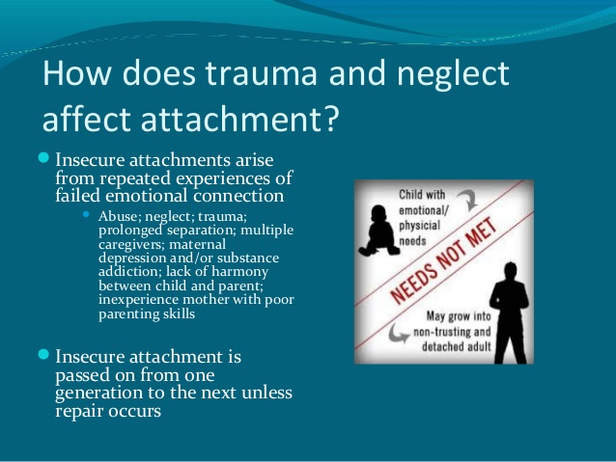

Slide 131
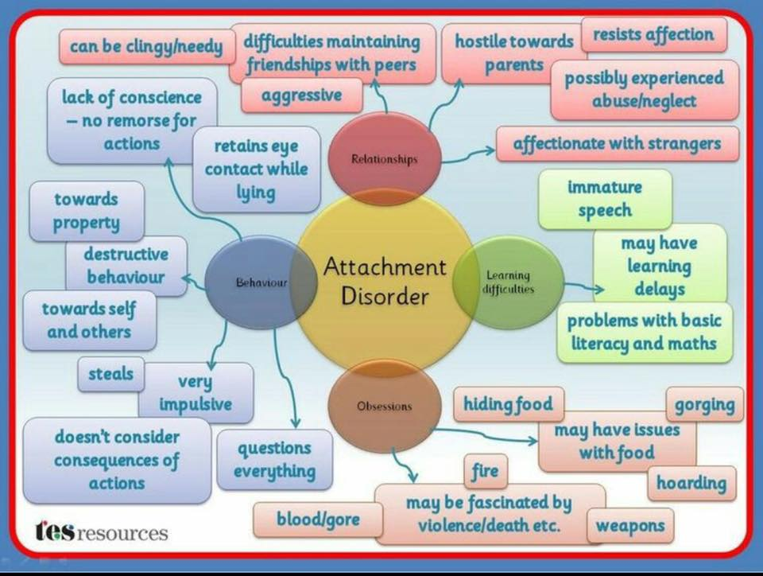

Slide 132
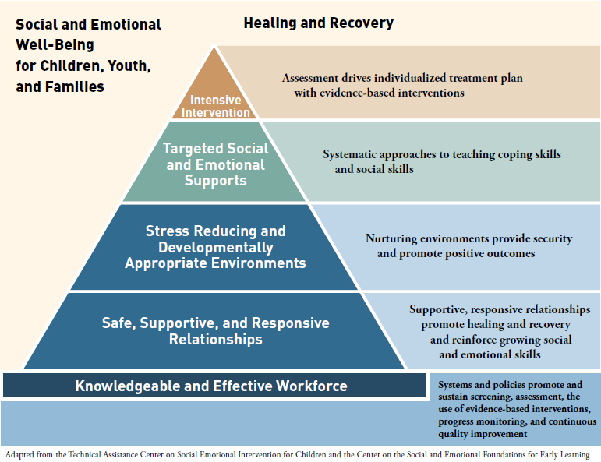

Slide 133
Please Visit
restoring the Mosaic.ca
For up to date information, research and articles on this and many other crucial matters
Pertaining to health and wholeness

