Slide 1
Families… from Generation to Generation
Dr. A.E. Gillies

Slide 2
Created for Attachment
God attachment
Spousal attachment
Parental attachment

Slide 4
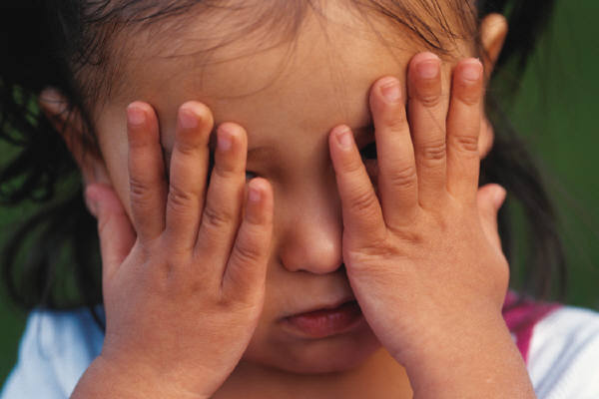
Need for Attachment
Attachment behaviors,
such as crying and
searching, are adaptive
responses to separation
from a primary
attachment figure—
someone who provides
support, protection,
and care.

Slide 5
Fundamental question
Is the attachment figure nearby, accessible, and attentive?
“Yes," he or she feels loved, secure, and confident, and, behaviorally, is likely to explore his or her environment, play with others, and be sociable.
Notes:
According to Bowlby, the attachment system essentially "asks" the following fundamental question: Is the attachment figure nearby, accessible, and attentive?
If the child perceives the answer to this question to be "yes," he or she feels loved, secure, and confident, and, behaviorally, is likely to explore his or her environment, play with others, and be sociable. If, however, the child perceives the answer to this question to be "no," the child experiences anxiety and, behaviorally, is likely to exhibit attachment behaviors ranging from simple visual searching on the low extreme to active following and vocal signaling on the other

Slide 6
Fundamental Question
Is the attachment figure (parent) nearby, accessible and attentive?
“No," - the child experiences anxiety
and is likely to
exhibit searching
to extreme
vocal reaction
Notes:
and, behaviorally, is likely to exhibit attachment behaviors ranging from simple visual searching on the low extreme to active following and vocal signaling on the other
These behaviors continue until either the child is able to reestablish a desirable level of physical or psychological proximity to the attachment figure, or until the child "wears down," as may happen in the context of a prolonged separation or loss. In such cases or helplessness, Bowlby believed the child experiences despair and depression.

Slide 7
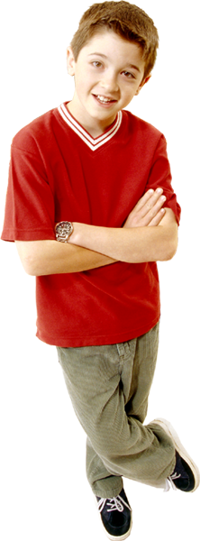
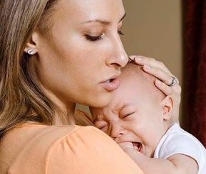
Process of Attachment
Is
the caregiver
near, attentive, responsive?
Felt security, love and confidence
Playful, less inhibited, smiling sociable
Separation distress & anxiety experienced
Attachment behaviours are activated to some degree,
Ranging from simple visual monitoring to intense protest

Slide 8
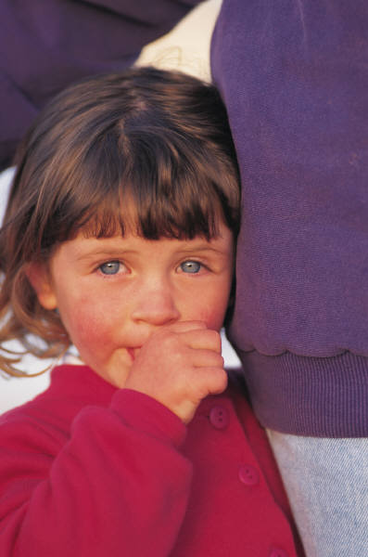
Secure vs Insecure Attachment
60% of children exhibit secure attachment (normative)
20% of children exhibit anxious-resistant
Ill-at-ease upon separation, become
extremely distressed
20% of children exhibit avoidant attachment
Don’t appear too distressed by separation
Upon reunion actively avoid seeking contact
with parent

Slide 9
Securely Attached
Feel safe when the caregiver is nearby and responsive
Engage in appropriate touch and hugs
Feel secure when parent/caregiver is inaccessible
Shares discoveries freely

Slide 10
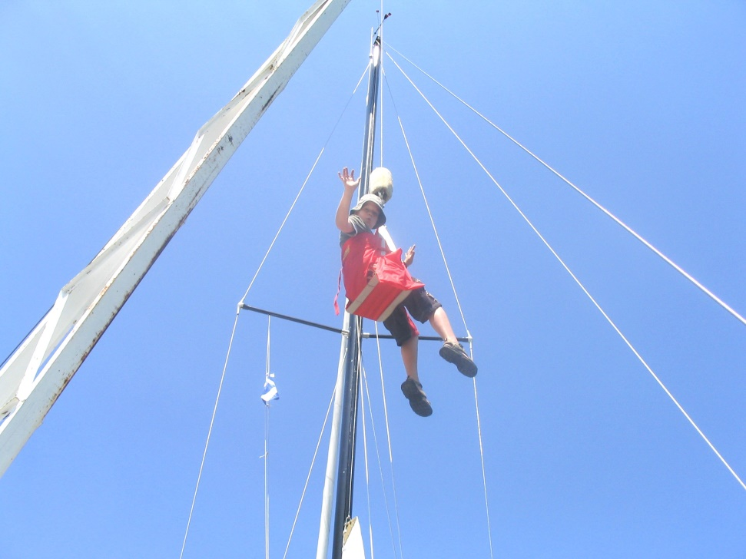
Secure Attachment
Secure:
connected with certainty,
comfortable with closeness,
doesn’t fear abandonment,
views self as loveable,
understands appropriate expression of emotions.

Slide 11
Disorganized Attachment
A small percentage of children experience disorganized attachment
Prone to dissociative experiences
Becomes a way of coping with deep trauma
Brain compartmentalizes trauma
Detachment from reality
Spacing out – part of you just isn’t there
at the moment.

Slide 12
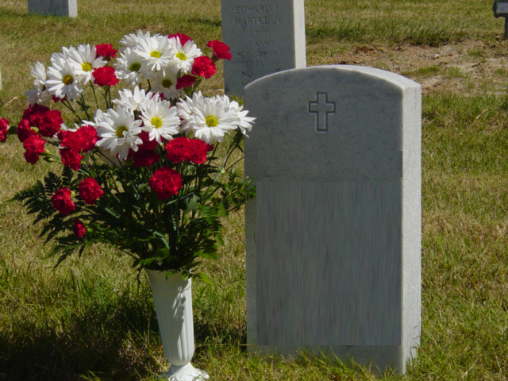
Cradle to Grave

Slide 13
Thank You!
Dr. Ann E. Gillies

Slide 14
Please Visit
restoring the Mosaic.ca
For up to date information, research and articles on this and many other crucial matters
Pertaining to health and wholeness

